Slide 1
PSYC100 GENERAL PSYCHOLOGY
LEARNING

Slide 2
Learning Outcomes
What is learning?
Behaviourist approaches
  Classical conditioning
  Operant conditioning
Cognitive approaches
  Tolman’s cognitive behaviourism
  Kohler’s insight learning

Slide 3
What is learning?
Learning, in the context of psychology, is defined as a relatively permanent change in behaviour, knowledge, capability, or attitude that occurs as a result of experience. This process involves the acquisition, modification, or strengthening of behaviours (and cognitive structures) through interaction with the environment, excluding changes due to maturation, fatigue, or temporary states (Ormrod, 2016).
e.g. maturation (e.g., a child walking due to physical development), fatigue (e.g., slower reactions when tired), or temporary states (e.g., altered behavior due to a mood swing

Slide 4
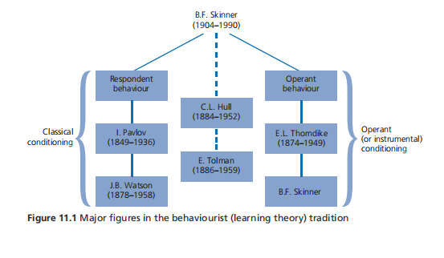

Slide 5
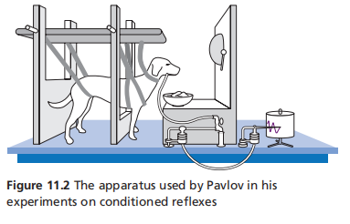
Classical Conditioning- Pavlov
Before conditioning, the taste of food will naturally and automatically make the dog salivate, but the sound of a bell won’t. So, the food is referred to as an unconditioned stimulus (UCS), and the salivation is an unconditioned response (UCR) – an automatic, reflex, biologically built-in response. The dog doesn’t have to learn to salivate in response to food, because it does so naturally.
During conditioning, the bell is paired with the food. Because the bell doesn’t naturally produce salivation, it’s called a conditioned stimulus (CS): it only produces salivation on the condition that it’s paired with the UCS. It’s also neutral with regard to salivation prior to conditioning.
If the bell and food are paired often enough, the dog starts to salivate as soon as it hears the bell and before the food is presented. When this occurs, conditioning has taken place. The salivation is now referred to as a conditioned response (CR), because it’s produced by a conditioned stimulus (CS) – the bell.

Slide 6
Classical conditioning
Generalisation – responding to all similar sounds
Discrimination – responding only to the conditioned sound
Extinction – the response is inhibited if the bell is not paired with food (not totally eliminated)
Spontaneous recovery – salivation reappears

Slide 7
Classical conditioning and phobias
The case of Little Albert (Watson and Rayner, 1920) - conditioning.
The case of Little Peter (Jones, 194) - unconditioning.
"Little Albert" experiment (1920), where a baby was conditioned to fear a white rat through classical conditioning. In contrast, Jones aimed to uncondition or desensitize a fear response in a young child, demonstrating that phobias could be reversed through gradual exposure and positive associations.

Slide 8
Classical conditioning and phobias
"Little Peter" was a healthy, intelligent boy approximately 2 years and 10 months old. Peter exhibited a strong phobia of furry animals, particularly a white rat, but this fear generalized to similar stimuli like rabbits, fur coats, feathers, and cotton wool (but not to non-furry objects like wooden blocks). His reactions included crying, fleeing, and physiological signs of distress (e.g., sweating, rapid heartbeat).
Peter was seated at a table with his favorite foods (e.g., candy, crackers, milk) to create a positive emotional state. The feared stimulus (starting with the rat, then shifting focus to the rabbit as it elicited stronger fear) was introduced at a safe distance (e.g., across the room).
Over sessions, the distance was gradually reduced while maintaining the pleasant activity, associating the stimulus with enjoyment rather than fear.
Peter's terror subsided progressively. He stopped crying when the rabbit was nearby, began tolerating closer proximity, and eventually petted and held the rabbit without distress—sometimes even enjoying it while eating.

Slide 9
Classical conditioning and phobias
Think about your phobias
Is it a learned behaviour?
How can we treat these phobias?
  Exposure therapy – systematic desensitization

Slide 10
Operant conditioning
Edward Thorndike’s experiments, particularly his work with cats in puzzle boxes, were foundational to the development of operant conditioning, a learning process later expanded upon by B.F. Skinner. Thorndike’s research is a cornerstone of operant conditioning.

Slide 11
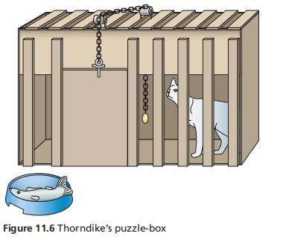
Thorndike
Procedure – re. image
Observations- Initially, the cat engaged in random behaviours (e.g., scratching, clawing, or biting the box) in an attempt to escape, “trial-and-error learning”; Over time, the cat began to associate the specific action (e.g., pressing the lever) with the consequence of escaping and receiving food; With repeated trials, the time taken to escape decreased significantly, as the cat learned to perform the correct action more quickly and efficiently.
Key Finding: “Law of Effect” behaviours followed by satisfying consequences were more likely to be repeated, while behaviours followed by unsatisfying consequences were less likely to occur again.

Slide 12
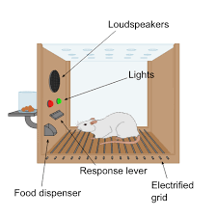
Skinner
Procedure: re image
Observations: Initially, the rat would explore the box and accidentally press the lever, receiving a food pellet. Over time, the rat learned to associate lever-pressing with the reward, increasing the frequency of this behaviour; Skinner noted that the rate and pattern of lever-pressing depended on the type and timing of the consequences. For instance: Continuous reinforcement (reward every time the lever was pressed) led to rapid learning. Intermittent reinforcement (reward delivered only occasionally, e.g., every third press or at random intervals) made the behaviour more resistant to extinction (stopping when rewards ceased); If a punishment (e.g., a mild shock) was delivered after lever-pressing, the behaviour decreased.
Key Finding: Skinner’s experiments demonstrated that behaviour is shaped by reinforcement (consequences that increase behaviour) and punishment (consequences that decrease behaviour).

Slide 13
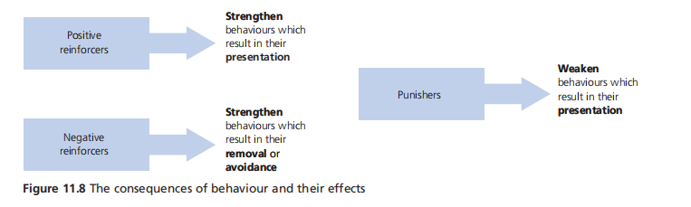

Slide 14
Some examples
Positive reinforcement - An employee meets a sales target and receives a bonus. This motivates them to continue working hard to achieve future bonuses.
Negative reinforcement - A driver buckles their seatbelt to stop the car's annoying warning beep. The removal of the beep encourages consistent seatbelt use.
Positive punishment - A teenager breaks curfew and is assigned extra chores by their parents. The added chores discourage future curfew violations.
Negative punishment - A driver receives a speeding ticket, resulting in the loss of money (fine). This financial penalty discourages speeding in the future.

Slide 15
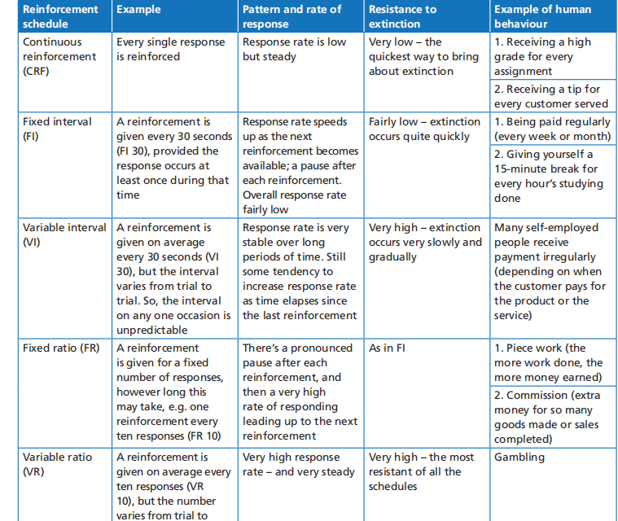
Schedules of reinforcement

Slide 16
Comparison of CC and OC
They’re both types of associative learning.
In CC, learning happens involuntarily, in OC learning is voluntary.
In CC, the stimulus is guaranteed to produce the response, while the likelihood of a particular operant response being emitted is a function of the past consequences of such behaviour.
In CC, the UCS works in basically the same way regardless of whether it’s pleasurable or aversive; in OC, responses that result in pleasurable outcomes are likely to be repeated, while those that result in aversive outcomes aren’t.
In CC, the reinforcer is presented regardless of what the animal does and is presented before the response. In OC, the reinforcer is only presented if the animal emits some specified, pre-selected behaviour, and is presented after the behaviour.

Slide 17
Do principles of learning apply to all species?
According to the concept of preparedness (Seligman, 1970), animals are biologically prepared to learn actions that are closely related to the survival of their species (such as learned water or food aversions), and these prepared behaviours are learned with very little training. However, contraprepared behaviours are contrary to an animal’s natural tendencies, and so are learned with great difficulty, if at all.
  E.g. E.g. Susan Mineka (1980s) on rhesus monkeys showed they quickly learned to fear snakes after observing other monkeys react fearfully to them, even through video. This fear was acquired after just one or two exposures and persisted longer than fears conditioned to neutral stimuli like flowers.
Same for humans.
  E.g. Ohman et al. (1975) – humans can easily be conditioned to fear spiders and snakes, but not to flowers, houses or berries.

Slide 18
Do principles of learning apply to all species?
  Fear of heights: conditioning studies where fear of heights is easily strengthened (Gibson & Walk, 1960)
  Fear of the dark: Studies (e.g., Grillon et al., 1997) show that fear responses to dark environments paired with aversive stimuli (e.g., loud noises) are stronger and more resistant to extinction than fears of bright, open spaces.
  Öhman and Mineka’s work contrasted fear conditioning to evolutionarily relevant stimuli (snakes) with modern ones (electrical outlets). While shocks paired with outlets can induce fear, it requires more trials, is weaker, and extinguishes faster compared to snake-related fears.

Slide 19

Cognitive approaches
Social Learning Theory (Bandura, 1977): While not denying the role of both classical and operant conditioning, SLT focuses on observational learning (or modelling), in which cognitive factors are crucial.
  e.g. Bobo doll experiment
Tolman’s Cognitive Behaviourism – his maze experiments, particularly his work with rats in the 1930s, were pivotal in challenging the strict behaviourist views of learning and introducing the concept of cognitive learning.
Kohler’s experiment with chimps.

Slide 20
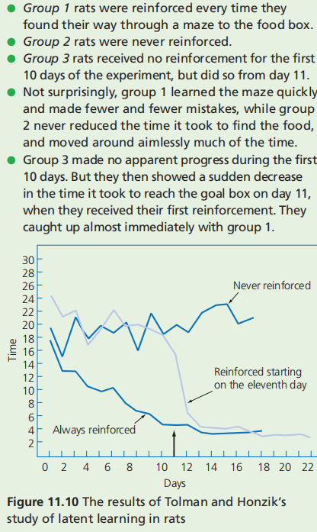
Tolman concluded that Group 3 had been learning the maze’s layout during the non-rewarded trials, even though they didn’t demonstrate this learning until a reward was introduced. This phenomenon was termed latent learning (“cognitive maps”)

Slide 21
Comparison of operant conditioning and latent learning
Operant conditioning, as developed by Skinner, emphasizes that behaviours are shaped by immediate consequences (reinforcement or punishment). Tolman’s findings showed that learning can occur without immediate reinforcement and be expressed later when a reinforcer is introduced.

Slide 22
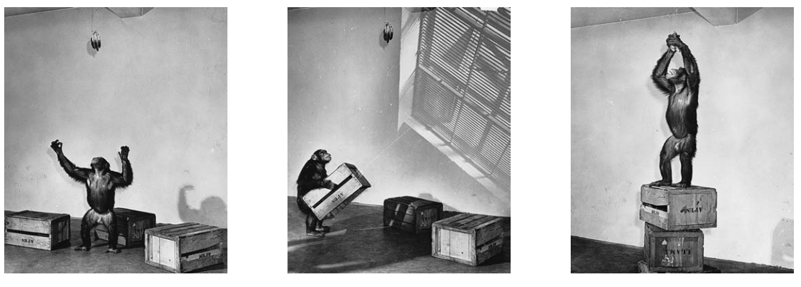
Tolman concluded that Group 3 had been learning the maze’s layout during the non-rewarded tria
Kohler (1925) has demonstated that chimps learn by INSIGHT (the sudden perception of a useful relationship that helps to solve a problem).

Slide 23
What about learned helplessness?
A condition where an individual/animal, after repeated exposure to uncontrollable negative events, develops a belief that they cannot influence outcomes, leading to passivity and reduced motivation to act, even when control is possible (Seligman, 1960s).
Classical Conditioning: Learned helplessness involves associating an aversive stimulus with a lack of control, leading to a conditioned response of helplessness or resignation.
Operant Conditioning: When actions (e.g., attempts to escape or solve a problem) consistently fail to produce desired outcomes, the individual learns that their behavior has no effect, reducing future attempts (negative reinforcement of passivity).
Cognitive Learning: The cognitive aspect of learned helplessness emphasizes the role of perception and belief. Individuals internalize the idea that they are powerless, which shapes their expectations and behavior in new situations.

Slide 24
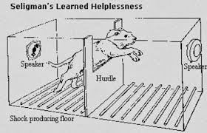
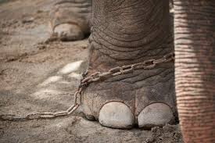
Learned helplessness

Slide 25
Lecture summary
Behaviourist approaches
Classical conditioning - Pavlov, Watson
Operant conditioning - Thorndike, Skinner
Cognitive approaches
Tolman
Kohler

